Slide 1
PESU I/O ML PROJECT
- Nidhi Gupta
PES2201900392

Slide 2
INTRODUCTION

Slide 3
LOGISTIC REGRESSION
PROJECT TITLE : PREDICTING HOW MANY USERS BOUGHT AN IPHONE

Slide 4
LOGISTIC REGRESSION vs LINEAR REGRESSION
Logistic regression predicts categorical outcomes (binomial/multinomial values of y), whereas linear Regression is good for predicting continuous-valued outcomes (such as the weight of a person in kg, the amount of rainfall in cm).

Slide 5
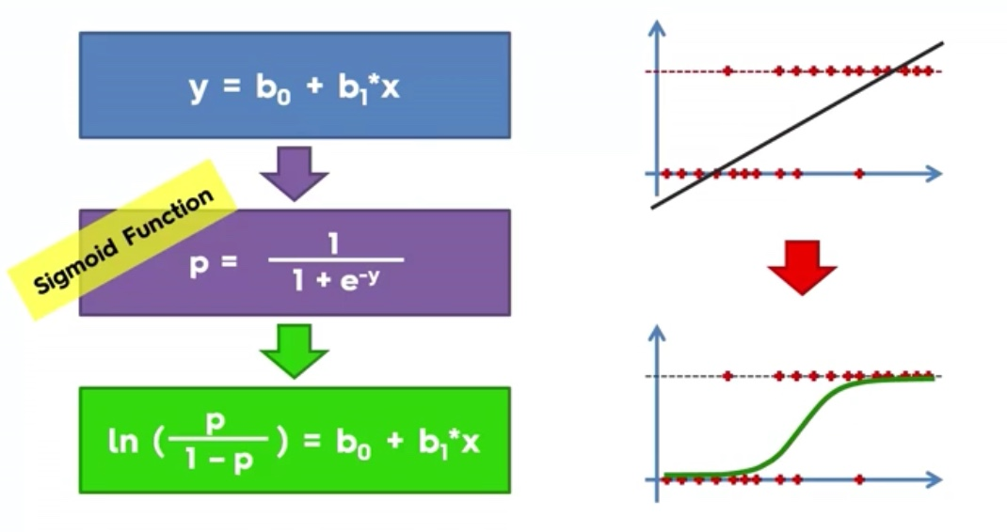

Slide 6
LOGISTIC REGRESSION
Logistic Regression is a linear model.
Note: Logistic Regression can be used for as many independent variables as we want. However we should be aware that we won’t be able to visualize the results in more than 3 dimensions.

Slide 7
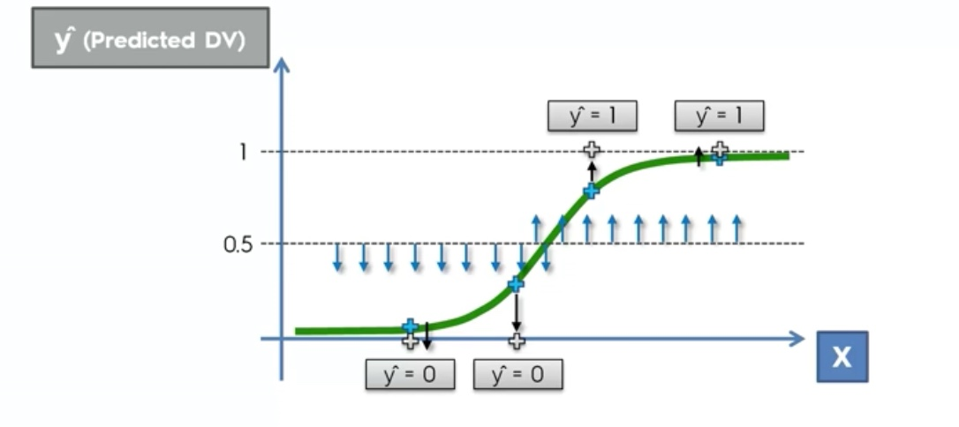

Slide 8
PROJECT

Slide 9
HOW PESU I/O HELPED ME

Slide 10
THANK YOU

